Slide 1
Subsetting, missing values and dates in R

Slide 2
From assignment to selection
Remembering vectors such as
X <- c(1,2,3,4)
How do we access some of X?
E.g. if we only want the 3rd element?
ANSWER: subsetting!

Slide 3
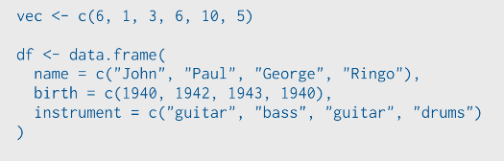
This is an example from Rstudio team
Run the following code in your head:

Slide 4
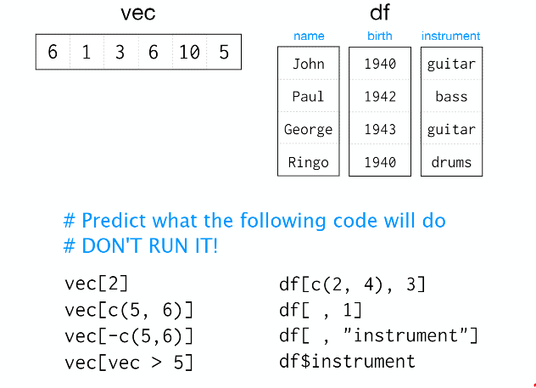

Slide 5
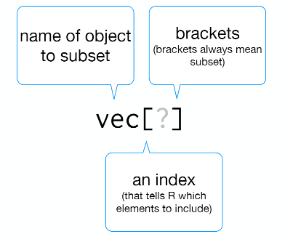
Subset notation

Slide 6
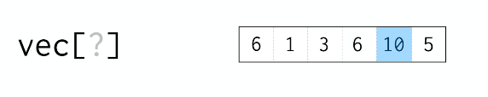
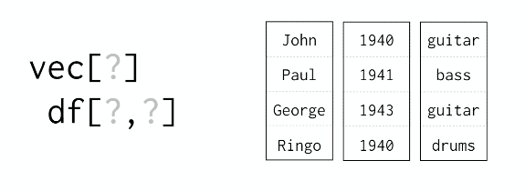
Each dimension needs it own index

Slide 7
Four ways to subset in R
Integers
Blank spaces
Names
Logical vectors (i.e. TRUE/FALSE)

Slide 8
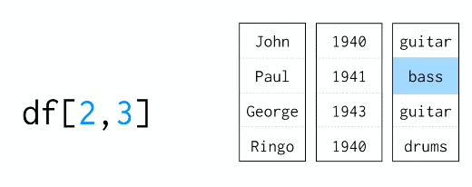
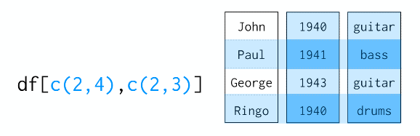
Integers
Just like ij notation from linear algebra
Can pass more than on index

Slide 9


Special cases
Colons
These give a range from i to j is i:j
Useful for creating vectors and repeating outputs
Zero
Returns nothing so empty object
Negative integer
Returns everything EXCEPT the index specified

Slide 10
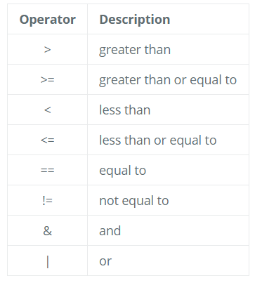
Using logical operators
We can also use indices with logical operators. Logical operators include greater than (>), less than (<), and equal to (==). A full list of logical operators in R is displayed below:

Slide 11

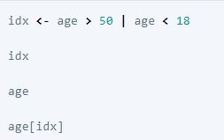
If we want to know if each element in our vector is, say greater than 50, we can write
vec > 50
Which would return
We can extend this to multiple logical conditions such as

Slide 12
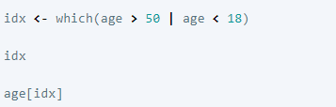
Indexing with logical operators using the which() function
While logical expressions will return a vector of TRUE and FALSE values of the same length, we could use the which() function to output the indices where the values are TRUE. Indexing with either method generates the same results, and personal preference determines which method you choose to use. For example:

Slide 13
Missing data
As R was designed to analyse datasets, it includes the concept of missing data (which is uncommon in other programming languages)
Missing data are represented in vectors as NA.
When doing operations on numbers, most functions will return NA if the data you are working with include missing values.
This feature makes it harder to overlook the cases where you are dealing with missing data.
You can add the argument na.rm = TRUE to calculate the result while ignoring the missing values.

Slide 14
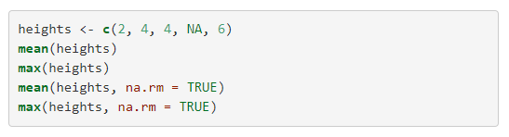

Slide 15
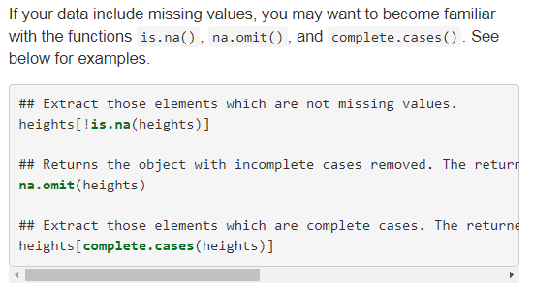
Useful NA functions

Slide 16
Factors
Factors are very useful and actually contribute to making R particularly well suited to working with data. So we are going to spend a little time introducing them.
Factors represent categorical data. They are stored as integers associated with labels and they can be ordered or unordered.
While factors look (and often behave) like character vectors, they are actually treated as integer vectors by R. So you need to be very careful when treating them as strings
Once created, factors can only contain a pre-defined set of values, known as levels. By default, R always sorts levels in alphabetical order.

Slide 17


Examples
R will assign 1 to the level "female" and 2 to the level "male" (because f comes before m, even though the first element in this vector is "male"). You can see this by using the function levels() and you can find the number of levels using nlevels():

Slide 18
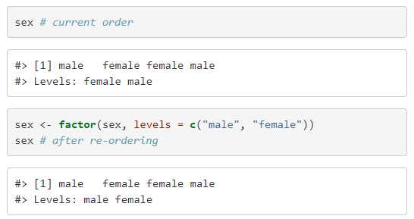
Level order
Sometimes, the order of the factors does not matter, other times you might want to specify the order because it is meaningful (e.g., “low”, “medium”, “high”), it improves your visualization, or it is required by a particular type of analysis. Here, one way to reorder our levels in the sex vector would be:
Notes:
In R’s memory, these factors are represented by integers (1, 2, 3), but are more informative than integers because factors are self describing: "female", "male" is more descriptive than 1, 2. Which one is “male”? You wouldn’t be able to tell just from the integer data. Factors, on the other hand, have this information built in. It is particularly helpful when there are many levels (like the species names in our example dataset)

Slide 19

Converting factors
To convert to a character vector use
In some cases, you may have to convert factors where the levels appear as numbers (such as concentration levels or years) to a numeric vector.
eg, in one part of your analysis the years might need to be encoded as factors (e.g., comparing average weights across years) but in another part of your analysis they may need to be stored as numeric values (e.g., doing math operations on the years).
as.numeric() returns the index values of the factor, not its levels, so it will result in an entirely new (and unwanted in this case) set of numbers.
One method to avoid this is to convert factors to characters, and then to numbers.

Slide 20
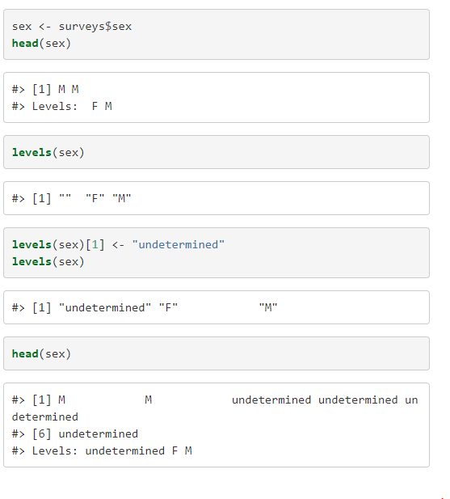
Renaming factors
When your data is stored as a factor, you can use the plot() function to get a quick glance at the number of observations represented by each factor level.
Example

Slide 21
Dates
One of the most common issues that new (and experienced!) R users have is converting date and time information into a variable that is appropriate and usable during analyses.
Simple practice for dealing with date data is to ensure that each component of your date is stored as a separate variable.
Using str(), we can confirm that our data frame has a separate column for day, month, and year, and that each contains integer values

Slide 22
Lubridate
We are going to use the ymd() function from the package lubridate (which belongs to the tidyverse; learn more here).
lubridate gets installed as part as the tidyverse installation.
When you load the tidyverse (library(tidyverse)), the core packages (the packages used in most data analyses) get loaded.
lubridate however does not belong to the core tidyverse, so you have to load it explicitly with library(lubridate)

Slide 23
Date formats
ymd() takes a vector representing year, month, and day, and converts it to a Date vector.
Date is a class of data recognized by R as being a date and can be manipulated as such.
The argument that the function requires is flexible, but, as a best practice, is a character vector formatted as “YYYY-MM-DD”.
Alternatives are YYYY/MM/DD or YYYY/DD/MM etc

Slide 24
